Slide 1

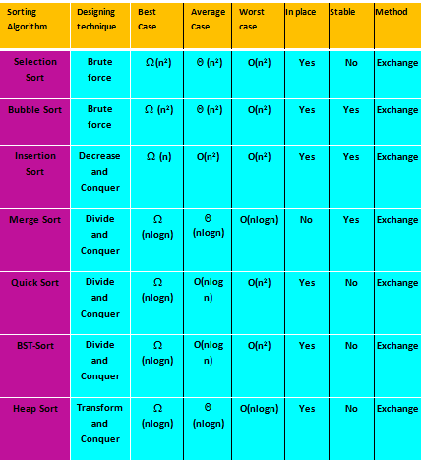
Comparison of various Sorting Algorithms

Slide 2
Final Term Exam Syllabus

Slide 3
Question 1 | Question 2 | Question 3 | Question 4
Unit 1-2 | Unit 3-5 | Unit 6-9 | Unit 10
CLO-1 | CLO-2 | CLO-3 | CLO-4
10% | 30% | 42% | 18%

Slide 4
Reharsal

Slide 5
Question 1
CLO 1: Apply inductive proofs techniques to prove the correctness of an algorithm.
Problem: Consider the following version of Binary Search algorithm
Suppose that we replace the line k = (i + j)/2 with k = j -2 in above algorithm. Is the resulting algorithm still correct (i.e., does it find the key if it is present and return -1 if is not present).Justify your answer
Input Parameter: L, I, j, key Output Parameters: None bsearch(L, i, j, key) { while( i ≤ j) { k=(i + j)/2 if(key ==L[k]) // found return k if(key < L[k]) // search first part j = k-1 else // search second part i = k+1 } return -1 // not found

Slide 6
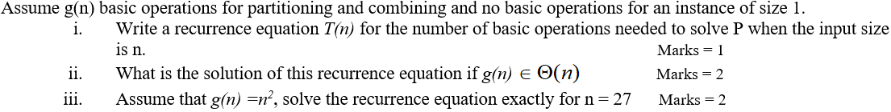
Question 2
CLO 2: Analyze the behavior of an algorithm using asymptomatic analysis.
Problem: Consider the algorithm solve given below. This algorithm solves problem P by finding the output (solution) O corresponding to any input I
void solve( input I, output O) { if (size (I) ==1) find solution O directly; else { Partition I into 5 inputs I₁,I₂, I₃, I₄,I₅, where size(I_{j}) =size(I)/3 for j=1..5 for(j=1; j<= 5; j++) Solve(I_{j}, O_{j}); Combine O₁,O₂, O₃, O₄,O₅ to get O for P with input I; } }

Slide 7
Question 2
CLO 2: Analyze the behavior of an algorithm using asymptomatic analysis.
Problem: Solve the following recurrence relation using recursion tree method
T(n) = T(9n/10) + T(n/10) + cn.

Slide 8
Question 2
CLO 2: Analyze the behavior of an algorithm using asymptomatic analysis.
Problem: How many comparisons (both successful and unsuccessful) will be made by the brute-force algorithm in searching for each of the following patterns in the binary text of one thousand zeros?
a. 00001 b. 10000 c. 01010

Slide 9
Question 2
CLO 2: Analyze the behavior of an algorithm using asymptomatic analysis.
Problem: How much slower does each of following sorting algorithms get when you increase the input size by one?
Bubble Sort
Heap sort
Ternary Merge sort

Slide 10
Question 2
Suppose Algorithm 1 does f(n) = n² + 4n steps in the worst case, and Algorithm 2 does g(n) = 29n + 3 steps in the worst case, for inputs of size n. For what input sizes is Algorithm 1 faster than Algorithm 2 (in worst case).

Slide 11
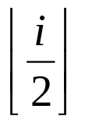
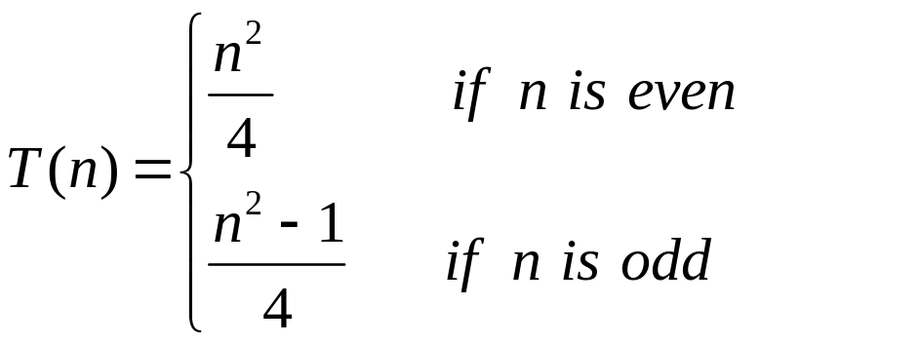
Question 2
Let T(n) denotes the number of times the statement x = x + 1 is executed in the following loop
for i = 1 to n do
for j = 1 to do
x = x + 1
Show that

Slide 12
Question 2
CLO 2: Analyze the behavior of an algorithm using asymptomatic analysis.
Problem: Suppose you have two sorting algorithms with n2 and n log n running times in worst case. (Assume these are the exact number of operations performed as a function of the input size n.) Suppose you have a computer that can perform 1010 operations per second, and you need to compute a result in at most an hour of computation. For each of the algorithms, what is the largest input size n for which you would be able to get the result within an hour?

Slide 13
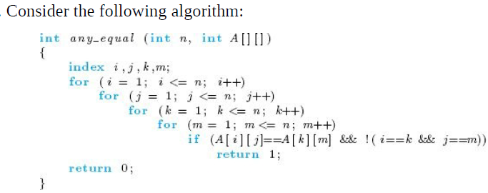
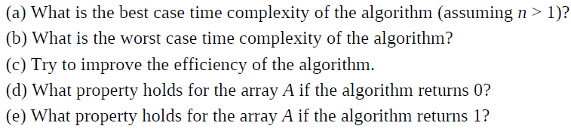
Question 2
CLO 2: Analyze the behavior of an algorithm using asymptomatic analysis.
Problem:

Slide 14
Question 3
CLO 3: Design an algorithm for a computational problem by employing an appropriate algorithmic approach.
Problem: Design a Θ(log(n)) algorithm that computes the remainder when x^{n} is divided by p. For simplicity, you may assume that n is a power of 2. That is, n = 2^{k} for some positive integer k.

Slide 15
Question 3
CLO 3: Design an algorithm for a computational problem by employing an appropriate algorithmic approach.
Problem: Design a Θ(log(n)) algorithm that computes the remainder when x^{n} is divided by p. For simplicity, you may assume that n is a power of 2. That is, n = 2^{k} for some positive integer k.

Slide 16
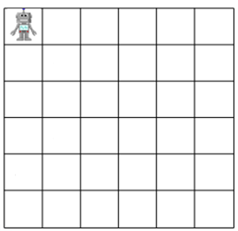
Question 3
Imagine a robot sitting on the upper-left corner of an MxN grid. The robot can only move in two directions at each step: right or down. Design an algorithm using dynamic programming to compute the number of possible paths for the robot to get to the lower-right corner. What is the complexity of your algorithm?

Slide 17
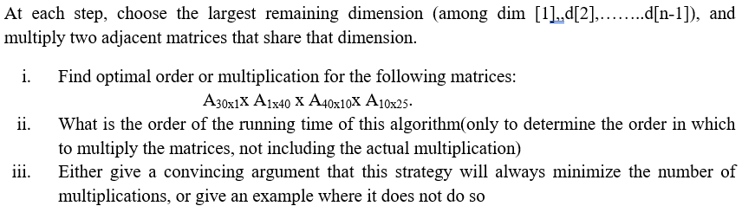
Question 3
Let A₁, A₂ , . . . . A_{n} be matrices where the dimensions of Ai are d_{i-1}x_{di}, for I = 1,2,……n. Here is proposal for a greedy algorithm to determine the best order in which to perform the matrix multiplications to compute A₁x A₂ x . . . . x A_{n}.
greedyOrder(dim,n)
{
At each step, choose the largest remaining dimension (among dim d[1],,d[2],……..d[n-1]), and multiply two adjacent matrices that share that dimension.
}

Slide 18
Question 4
CLO 4: Explain the concept of computability with examples.
Problem: Given a positive integer n, are there integers j, k > 1 such that n = jk?(that is, is n nonprime?)

Slide 19
Question 4
CLO 4: Explain the concept of computability with examples.
Problem: Suppose algorithm A1 and A2 have worst case time bound p and q, respectively. Suppose algorithm A3 consisting of applying A2 to the output of A1. Give a worst case time bound for A3.

Slide 20
Question 4
CLO 4: Explain the concept of computability with examples.
Problem: Clique is an NP complete problem. Suppose a polynomial time algorithm is discovered that correctly computes the largest clique in a given graph. In this scenario, in which class Clique problem belongs.

Slide 21
The SALT of Life
Mathematics is a Science; it is an Art, it is a precise and concise Language; and it is a great problem solving Tool. Thus mathematics is the SALT of life. As food is tasteless without salt so life is tasteless without mathematics. You will see that mathematics is really fun, so enjoy the beauty and power of mathematics by designing ALGORITHMS.
TANVEER AHMED(2009)

Slide 22
So, whichever direction you take in your future journey through the land of algorithms in your studies and your career, the road ahead is as exciting as it has ever been. Not many areas of science and engineering can make this claim with the same assurance that algorithmics can.
Have a great trip!

Slide 23


